Slide 1
Click Kart The Modern Furniture Store
Presented By:
Yathish Kumar A 109537
Mustafeez 109538
Joy Kiran 109533
Ranjitha 1095....
Radha 1095....

Slide 2
Introduction
The Old fashioned ways of buying furnitures was bit difficult and unsafe.
The new trend is online which provides flexibility and choices .

Slide 3
Problem Statement
The people are facing major problems in selecting the furnitures.
This app helps the consumers a wide variety of choices in selecting thier needs.

Slide 4
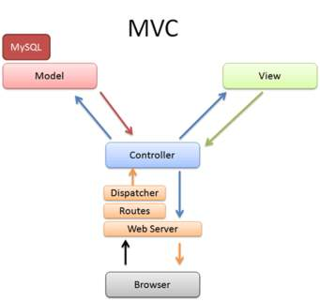
Project Architecture

Slide 5
Tools Used
The Major Tools used in this project is:
Eclipse
Angular
Sublime
Nodejs

Slide 6
Work flow of the applications

Slide 7
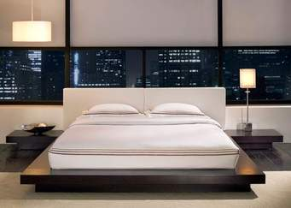
pictures

Slide 8
Contributions and Conclusion
BUY FROM CLICK KART
ONE SOLUTION FOR ALL YOUR NEEDS...

